Slide 1
Theory of Elasticity in Geotechnical Engineering
Lecture
Hadush Seged (Dr.)
December 29, 2009

Slide 2
Determination of Elastic Constants
To determine values of the elastic constants for a given soil deposit, we have to perform a test or perhaps several tests.
Laboratory Tests
Some conventional methods developed for shear strength determination will also give information on elastic constants. This is true for Triaxial Compression Testing. Other tests, such as the direct shear test, give little insight to the elastic constants.
In the triaxial test, a cylindrical sample of soil encased in a rubber membrane is subjected to a hydrostatic stress.
Sample volume change due to hydrostatic stress can be determined by simply measuring how much pore fluid is expelled from initially fully saturated sample.

Slide 3

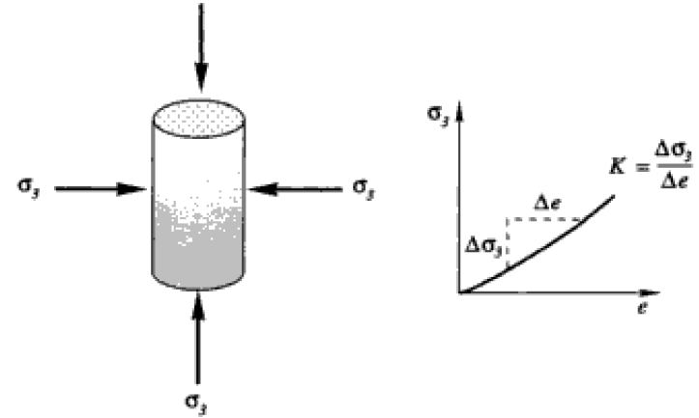


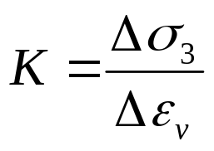
The cell pressure – volumetric strain relation will generally be non-linear (Figure 7.1).
The slope at the appropriate stress level can be used to estimate the bulk modulus K.
...(7.1)
FIG. 7.1: hydrostatic compression

Slide 4
A distinction between normally consolidated and over-consolidated states is important for bulk modulus determination.
An over-consolidated soil subjected to high stress levels may exhibit relatively elastic response in hydrostatic compression. The response will be reversible or nearly so. Besides, many over-consolidated soils will be relatively insensitive to sample disturbance, and good estimate for bulk modulus may be found.
In contrast, normally consolidated soils may not behave so nicely. At higher stresses (than the current in situ stress), normally consolidated soils may undergo irreversible volumetric strain due to rearrangement of the grain structure representing inelastic behavior.
Hence, values of K determined for normally consolidated soils must be approached with caution.

Slide 5
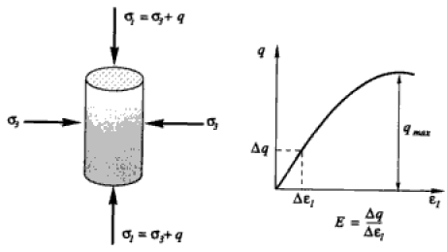

The second phase or deviatoric phase of a triaxial test provides more useful information concerning elastic constants.
In the deviatoric phase, the axial stress (σ₁) is increased while the radial stress (σ₃) is held constant (Figure 7.2).
The increase in axial stress is called deviatoric stress (q).
...(7.2)
FIG. 7.2: deviatoric phase

Slide 6
Young’s modulus E is the slope of q versus axial strain ε₁ curve.
Since q versus ε₁ curve is non-linear, conventional practice takes E to be the slope of the secant that joins the origin to a particular point on the curve. This point may correspond to the working stress level and is often taken to be one-third the maximum value for q.
The other elastic constant that can be obtained from a drained triaxial test is the Poisson’s ratio ν.
Poisson’s ratio can be found provided that the sample volume change is measured during application of the deviatoric stress.
Volume change measurement allows us to determine the volumetric strain ε_{v}.

Slide 7
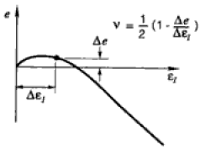



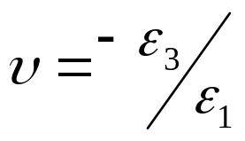
Volume change measurement allows us to determine the volumetric strain ε_{v}.
Type I
Type I: Loose sand, normally consolidated clay
Compression
Type II: Dense sand, over-consolidated clay
Volumetric strain
...(7.3)
Expansion
Type II
Poisson’s ratio
...(7.4)

Slide 8
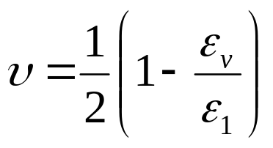
Combining equations (7.3) and (7.4) gives:
...(7.5)
The ε_{v} versus ε₁ curve is non-linear. Conventional practice suggests that Poisson’s ratio should be determined at the point on the ε_{v} – ε₁ curve that corresponds to the point on the q – ε₁ curve where E was determined.
The value of Poisson’s ratio, and specially the value of Young’s modulus will be dependent on the cell pressure used in the test.

Slide 9
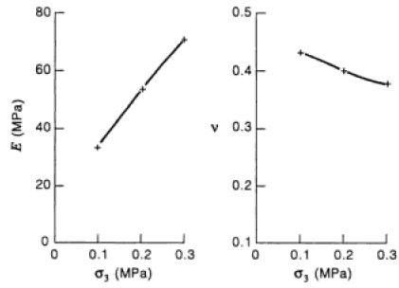
FIG. 7.3: Typical test result on actaul sand for dependence of E and ν on σ₃.

Slide 10
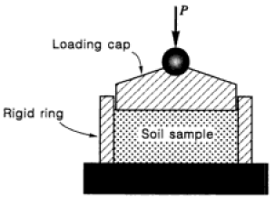
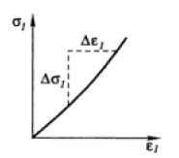
The second common laboratory test that offers information on elastic constants is the Oedometer test (or consolidation test).
In this test, a uniaxial vertical compressive load is applied on a thin sample, which is constrained from expanding horizontally by a rigid ring.
FIG. 7.4: Oedometer test configuration.

Slide 11
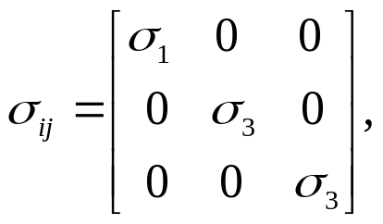
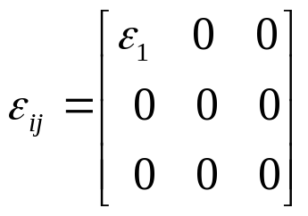
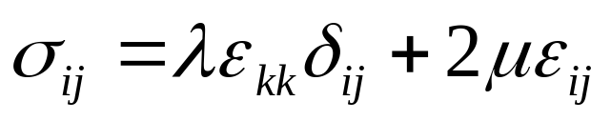
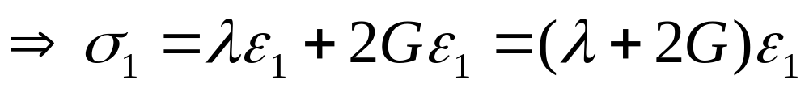
All deformation is vertical and the only nonzero strain is vertical compressive strain ε₁. The corresponding stress and strain matrices are:
...(7.6)
The volumetric strain ε_{v} is equal to the axial strain ε₁. Hence, Hooke’s law in the form of eqn. (6.11) will be:

Slide 12
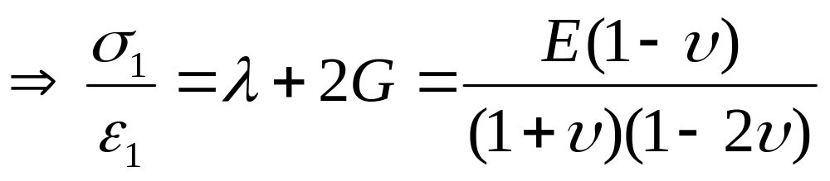
Using the relationship between elastic constants, we find:
...(7.7)
In general, the σ₁ versus ε₁ response is non-linear, and eqn. (7.7) must be applied to some appropriate part of the curve.
Note that a single elastic constant is not determined here, but in stead we find an algebraic combination of two constants. Hence, other tests are necessary to provide more information before individual constants can be determined.

Slide 13
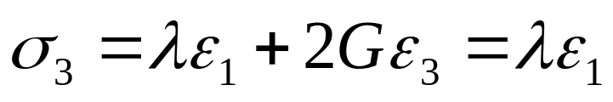
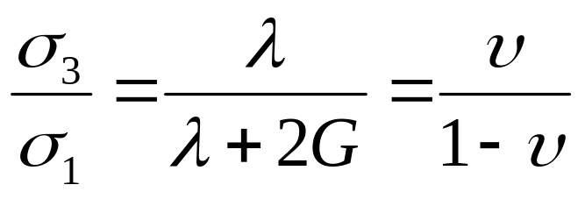
We can also make one more observation about the oedometer test. The rigid ring surrounding the sample applies the horizontal stress component σ₃, which from Hooke’s law is given by:
We see that the ratio of the horizontal to vertical stress is:
...(7.8)
Unfortunately, again eqn. (7.8) alone can not be used to determine E and ν because the radial stress is not easily measured.

Slide 14
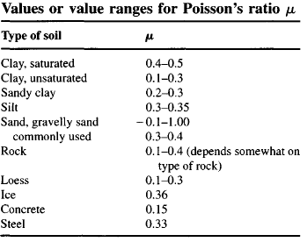

In conclusion, a single set of stress and strain data can, at best, determine only one elastic constant. It can also determine an algebraic combination of two constants, but it can not determine two constants independently.
Typical values (Bowles, 1996):

Slide 15
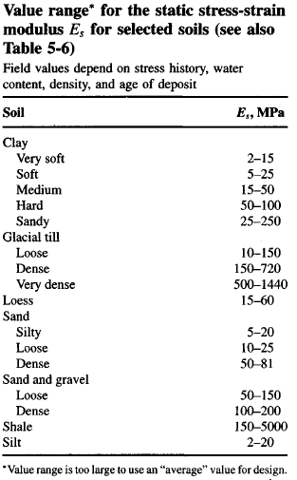

Slide 16
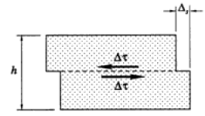
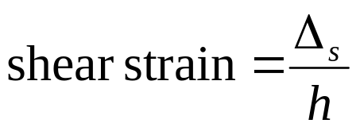
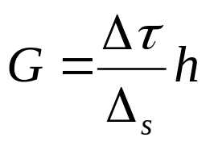
The other common laboratory strength test is the direct shear test (Figure 7.5).
Rough estimates for the shear modulus G can be obtained as follows:
FIG. 7.4: Direct shear test geometry
But because of the non-uniformity of both stress and strain fields (discontinuities and stress concentration occur on the soil near walls of the box ), these results must be used with caution.

Slide 17
There are other laboratory test methods that can be used to supply values for elastic constants, but these are mostly used in research and will rarely be available in ordinary practice.
Pure shear (simple shear) test, True triaxial test, etc. may be found in research laboratories but their use in not widespread to be encountered by most engineers.
The triaxial test remains our best tool for estimating elastic constants in the laboratory.

Slide 18
Field Tests
Field tests can be used as a complement to laboratory tests or can be exclusively used when sampling and sample disturbance appear to present significant difficulties for laboratory testing.
Two categories of field tests:
Correlative
Deterministic
The correlative test category uses simple test procedures whose results, based on experience, have been correlated to various soil properties including elastic constants.
The standard penetration test (SPT) and cone penetration test (CPT) are two most common methods.

Slide 19
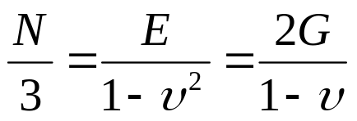
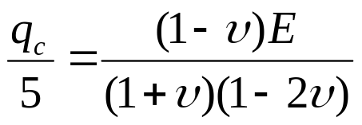
Two widely used correlations for sandy soils are:
Parry’s (1978) SPT Correlation:
Where N = number blows to produce a penetration of 300 mm, and E has a dimension of MPa.
Schmertmann’s (1970) CPT Correlation:
Where q_{c} = cone penetration resistance in kg/cm² and E in MPa.
Refer for more correlations in Foundation Analysis & Design by Bowles (1996), example page 316.

Slide 20
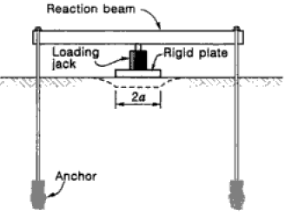
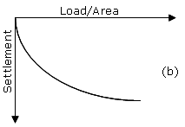
In contrast, to correlative testing, deterministic tests will generally give estimates with greater reliability, although generally at greater expense.
The most direct type of deterministic field test is the plate load test (Figure 7.5).
FIG. 7.5: Plate load test

Slide 21
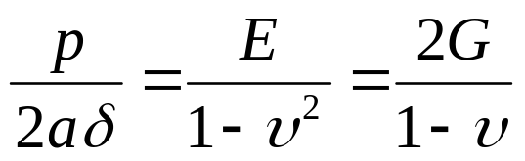
Assuming that the soil responds elastically, the exact elastic solution for a circular plate is:
...(7.8)
Where a = the plate radius p = the load on the plate, δ is the measured displacement of the plate.
Note that equation (7.8) is a combination of two constants rather than a single constant.
Most importantly note that the plot of p versus δ will not be a straight line. Hence, we will need to select an appropriate load level p.

Slide 22
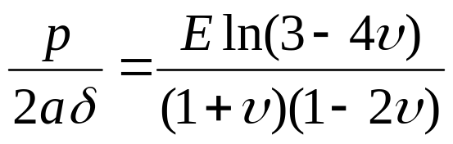
Equation (7.8) is derived based on the assumption that the base of the plate is smooth. Occasionally, plate load tests are performed with a cast-in-place concrete pad rather than a smooth steel plate. In this case a rough base (implying zero horizontal displacement beneath the plate) should be considered and eqn. (7.8) becomes:
...(7.9)
Equation (7.9) is also an exact elastic solution.
If the plate is square rather than circular, there is no exact solution but an approximate solution is available, which is given as:

Slide 23
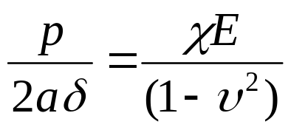
...(7.10)
where χ is a constant, equal to 0.877.

